Slide 1


Green Pace
Security Policy Presentation
Developer: Jacob Ledbetter

Slide 2

OVERVIEW: DEFENSE IN DEPTH

Slide 3
THREATS MATRIX
Severity, Likelihood, and Remediation Cost of a standard are assigned a 1-3 point value. Points are then multiplied together to create a priority from 1 - 27
Likely STD-002-INT STD-010-MEM | Priority STD-009-ARR STD-003-STR STD-005-MEM STD-002-INT STD-004-SQL STD-010-MEM
Low priority STD-006-DCL STD-001-DCL STD-008-INT STD-007-ERR | Unlikely STD-006-DCL STD-001-DCL

Slide 4
10 PRINCIPLES
Principles | Coding Standard
1. Validate Input Data | STD-002-INT,STD -003-STR, STD-004-SQL, STD-008-INT
2. Heed Compiler Warnings | STD-007-ERR, STD-009-ARR
3. Architect and Design for Security Policies
4. Keep It Simple | STD-001-DCL
5. Default Deny
6. Adhere to the Principle of Least Privilege
7. Sanitize Data Sent to Other Systems
8. Practice Defense in Depth | STD-004-SQL
9. Use Effective Quality Assurance Techniques | STD-005-MEM, STD-006-DCL, STD-010-MEM
10. Adopt a Secure Coding Standard

Slide 5
CODING STANDARDS
Rule | Severity | Likelihood | Remediation Cost | Priority | Level
STD-006-DCL | Low | Unlikely | High | P1 | L3
STD-001-DCL | Medium | Unlikely | Medium | P2 | L3
STD-008-INT | Low | Probable | High | P2 | L3
STD-007-ERR | Low | Probable | Medium | P4 | L3
STD-009-ARR | High | Probable | High | P6 | L2
STD-003-STR | Medium | Probable | Medium | P8 | L2
STD-005-MEM | Medium | Probable | Medium | P8 | L2
STD-002-INT | High | Likely | High | P9 | L2
STD-004-SQL | High | Probable | Medium | P12 | L1
STD-010-MEM | High | Likely | Medium | P18 | L1
Priority and Levels
- Severity, Likelihood, and Remediation Cost are assigned a 1-3 point value
- Points are then multiplied together to create a priority from 1 - 27
- Levels are ranges of priorities L3 (P1-P4), L2 (P6-P9), and L1 (P12-P27)
- Base on SEI CERT Oracle Coding Standards

Slide 6
ENCRYPTION POLICIES
Encryption in rest
This is the storing of data using encryption methods so that if someone attempts to access the data they will be unable to use it without the proper encryption/decryption algorithms and keys. This data is usually protected through several layers of security such as firewalls and anti-virus software
Encryption at flight
This is the process of using encrypted communications levels that the data will travel along. Such as HTTPS or SSL/TLS.
Encryption in use
This is the process of transforming the data before transit. This would include hashing passwords on input and comparing the hash password to the store data before providing access to a system.

Slide 7
TRIPLE-A POLICIES
Authentication
This is the process of validating a user or application. It’s making sure the person/app is who they say they are. Methods include usernames and password or additional levels such as 2 Factor Authentication and using something you know(username/password) with something you have (application the provides an randomly generated access key that the system also knows)
Authorization
Authorization is giving access to only what a user/application need. Here we using things such as roles and policies to determine if a user has the right authority to access a piece of the system, whether it’s a database, or functions that perform specific actions.
Accounting
This is the process of logging and auditing how your systems are used. It allows for someone with the right authorization to see who is doing what and if there are any signs of abuse to the system.

Slide 8
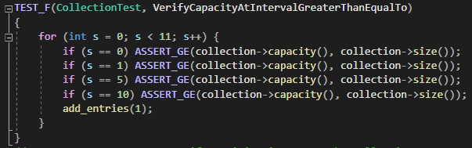
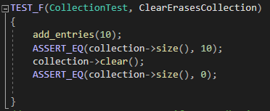
Vector Unit Testing
Tested various Vector functionalities that falls with in our STD-010-MEM coding standard.
Shows the capacity of the Vector will always be greater than the size.
Shows the vector is truly empty after performing a clear() method on the vector.

Slide 9
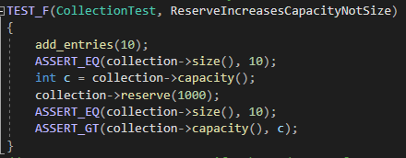
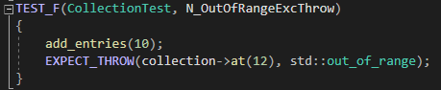
Vector Unit Testing
This Vector test will throw an exception and falls into the “Heed Compiler Warnings” policy. Here we are trying to access and object outside the current vector size.
Testing that we can increase the reserved memory of a vector without changing the size of the vector. If the size of the vector changed that would suggest an element had been added or removed.

Slide 10

AUTOMATION SUMMARY

Slide 11
TOOLS
The DevSecOps pipeline is the process of incorporating security practices into the Software Development Life Cycle.
From Start to Finish security practices should be intertwined into our project.
Some of the tools we want to use are static analysis tools and unit testing tools.
Use them in the Build and Verify and Test phases.

Slide 12
RISKS AND BENEFITS
Risk of not going with a DevSecOps Pipeline
Increased remediation cost.
Higher Chances of vulnerabilities baked into the system.
Benefits of a DevSecOps Pipeline
Secure Code
Higher Quality Product
Quicker response times if something were to break.

Slide 13
RECOMMENDATIONS
No Encryption Standards
No Standards for Authorization
We have discussed both Encryption and Triple-A Policies, but currently do not have any standards setup for handling inbound and outbound data transfer which correlate directly to both.

Slide 14
CONCLUSIONS
Encryption a lot of times involves shifting and padding of a value with a secret. This standard should be added to remediate issues that would change our encrypted values in unanticipated ways.
Do not shift an expression by a negative number of bits or by greater than or equal to the number of bits that exist in the operand

Slide 15
REFERENCES
Carnegie Mellon University. (2020). Rec.: Priority and Levels - SEI CERT Oracle Coding Standard for Java - Confluence. Carnegie Mellon University Software Engineering Institute. https://wiki.sei.cmu.edu/confluence/display/java/Rec.%3A+Priority+and+Levels

